Slide 1
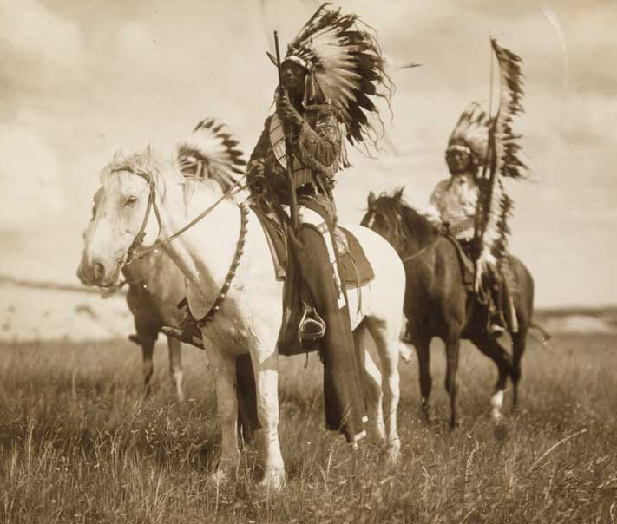
Native Americans
Part 6-
Plains Indians

Slide 2
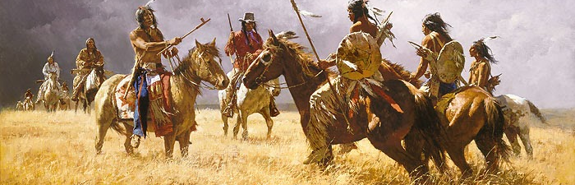
The Native American tribes that lived on the Great Plains are known as the Plains Indians.

Slide 3
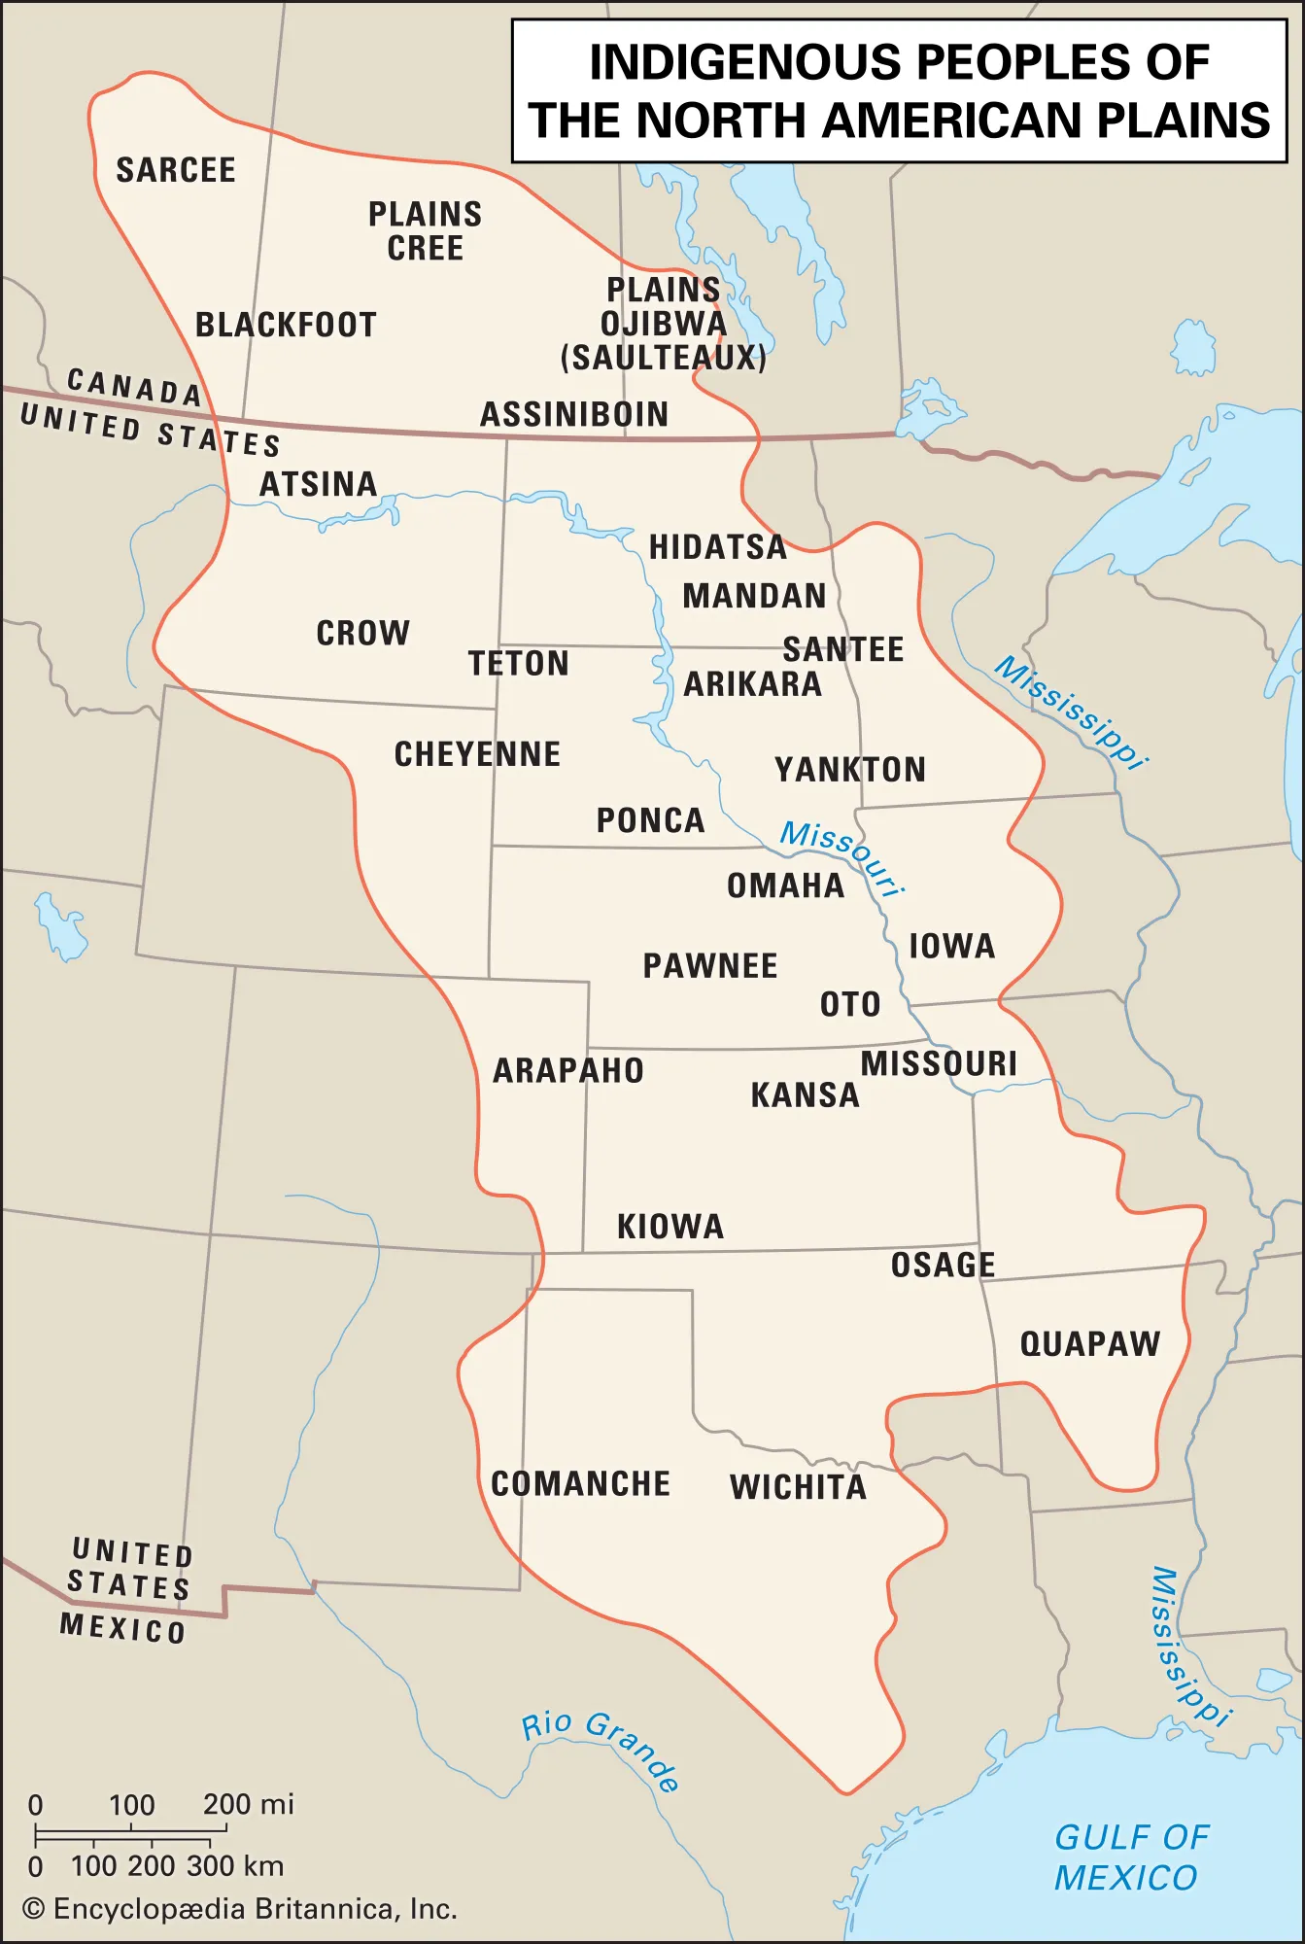
There were more than 30 different tribes who called this region their home.

Slide 4
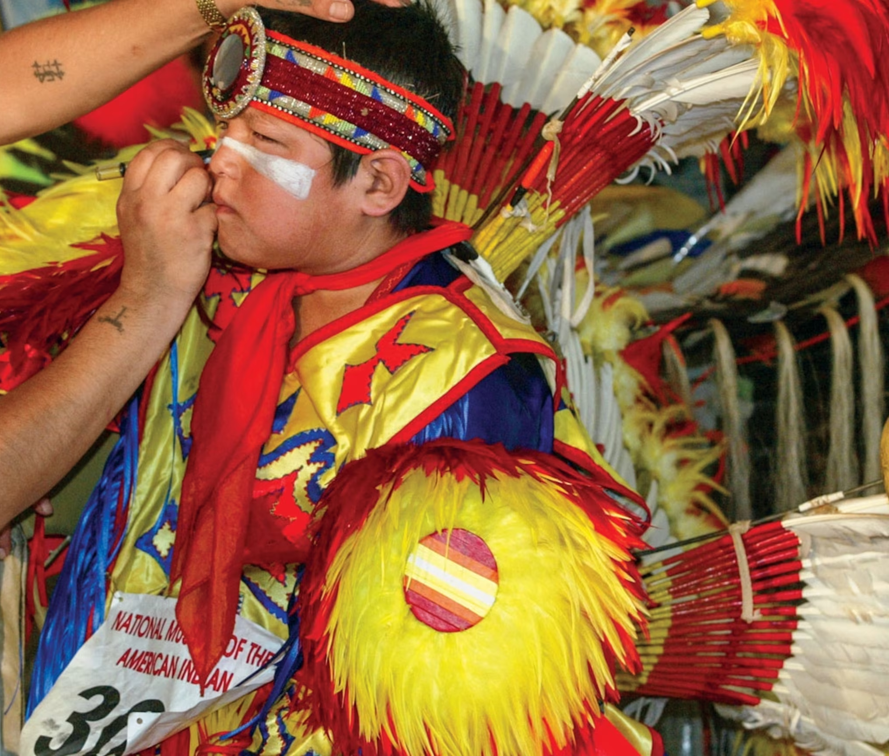
These tribes differed culturally. Each of these tribes had their own language, religious beliefs, and customs.

Slide 5
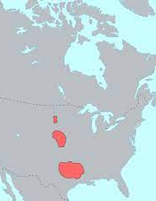
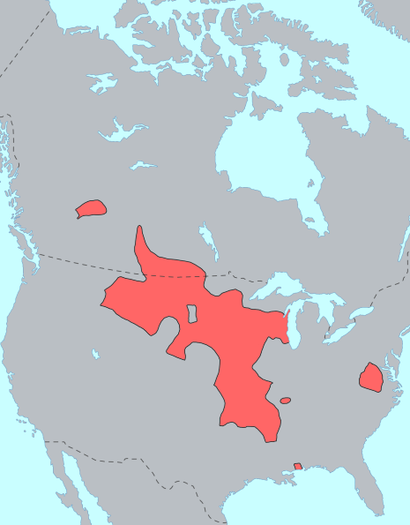
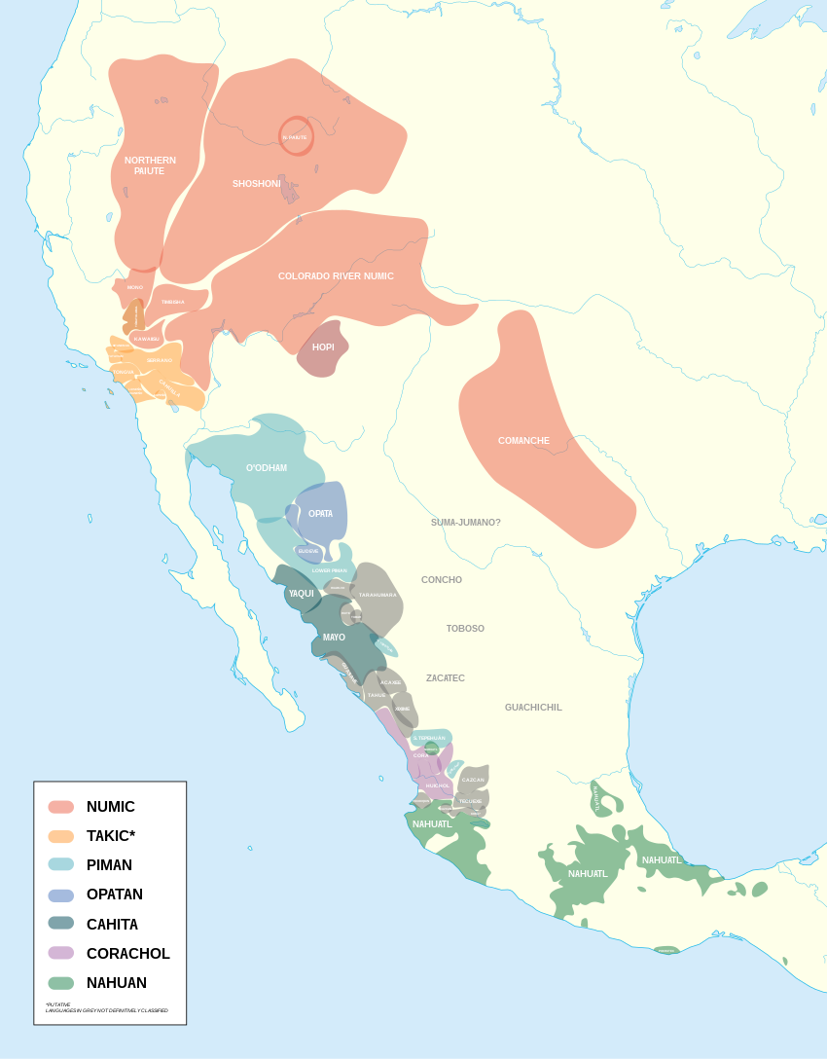
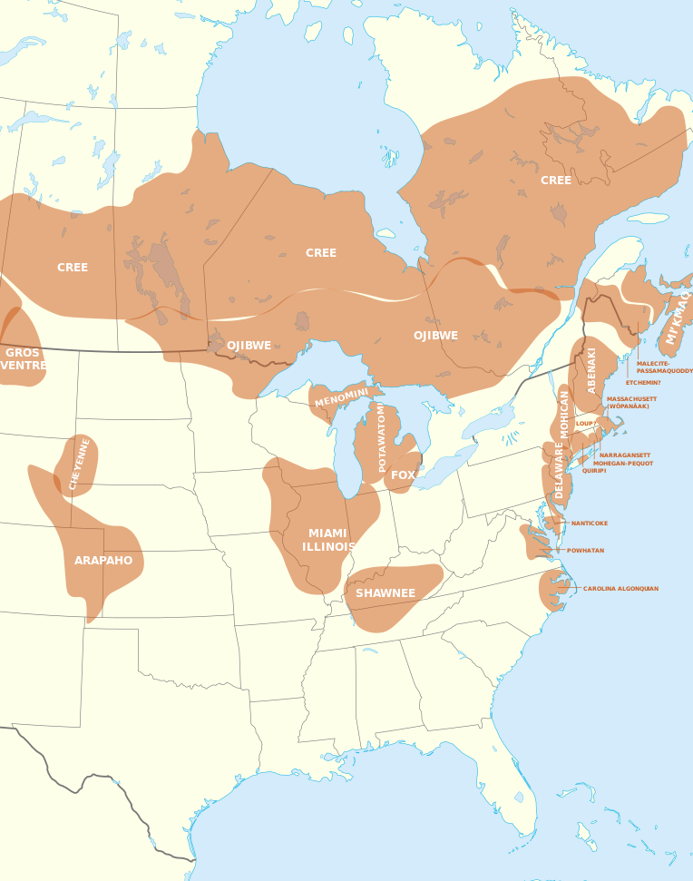
Plains Indians spoke several different languages. These include Algonquian, the Siouan language, Caddoan, and the Uto-Aztecan language.

Slide 6
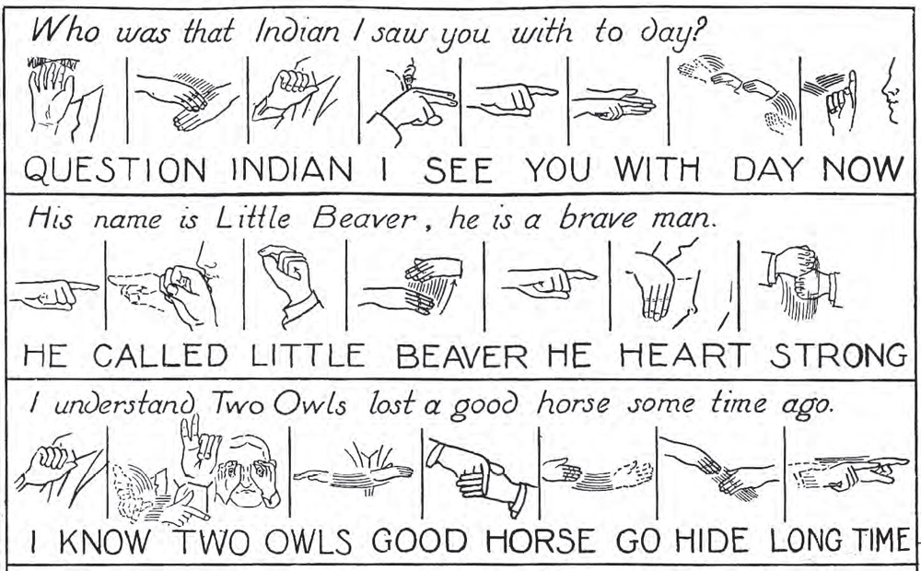
There was also a universal sign language that was used throughout the Plains region by many tribes.

Slide 7
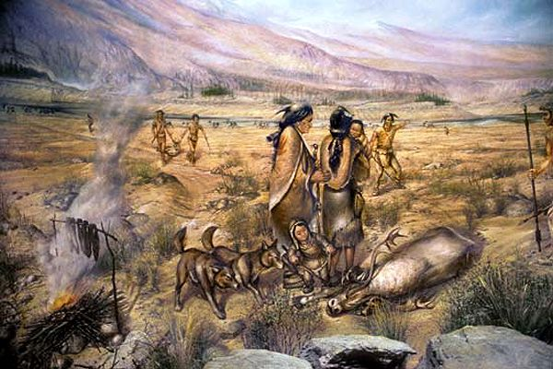
Before horses were introduced to America by the Spanish in the 1500s, most of the Plains Indian tribes lived in the river valleys at the edge of the Plains.

Slide 8
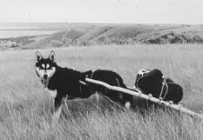
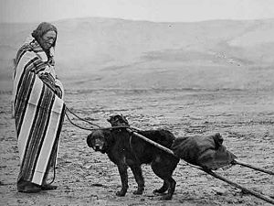
They would use trained dogs to help them pull packs across the land.

Slide 9
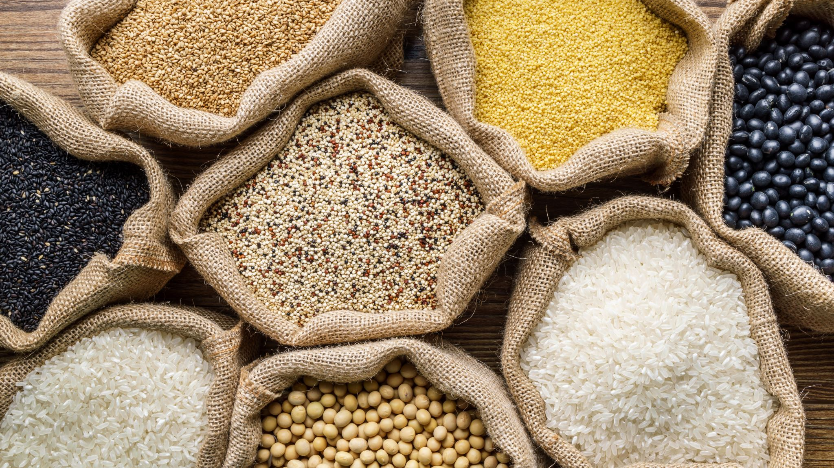
These Native Americans were farmers, growing corn, squash, beans, sunflowers, and tobacco.

Slide 10
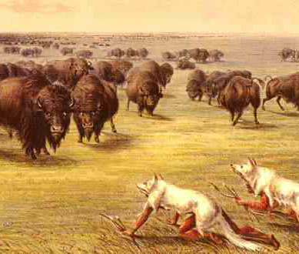
Women did most of the farming while the younger men hunted primarily buffalo.

Slide 11
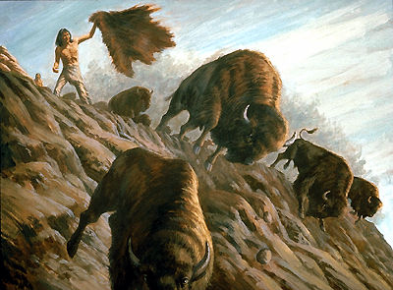
These hunters would drive the buffalo into a corral to trap them or chase them off a cliff.

Slide 12
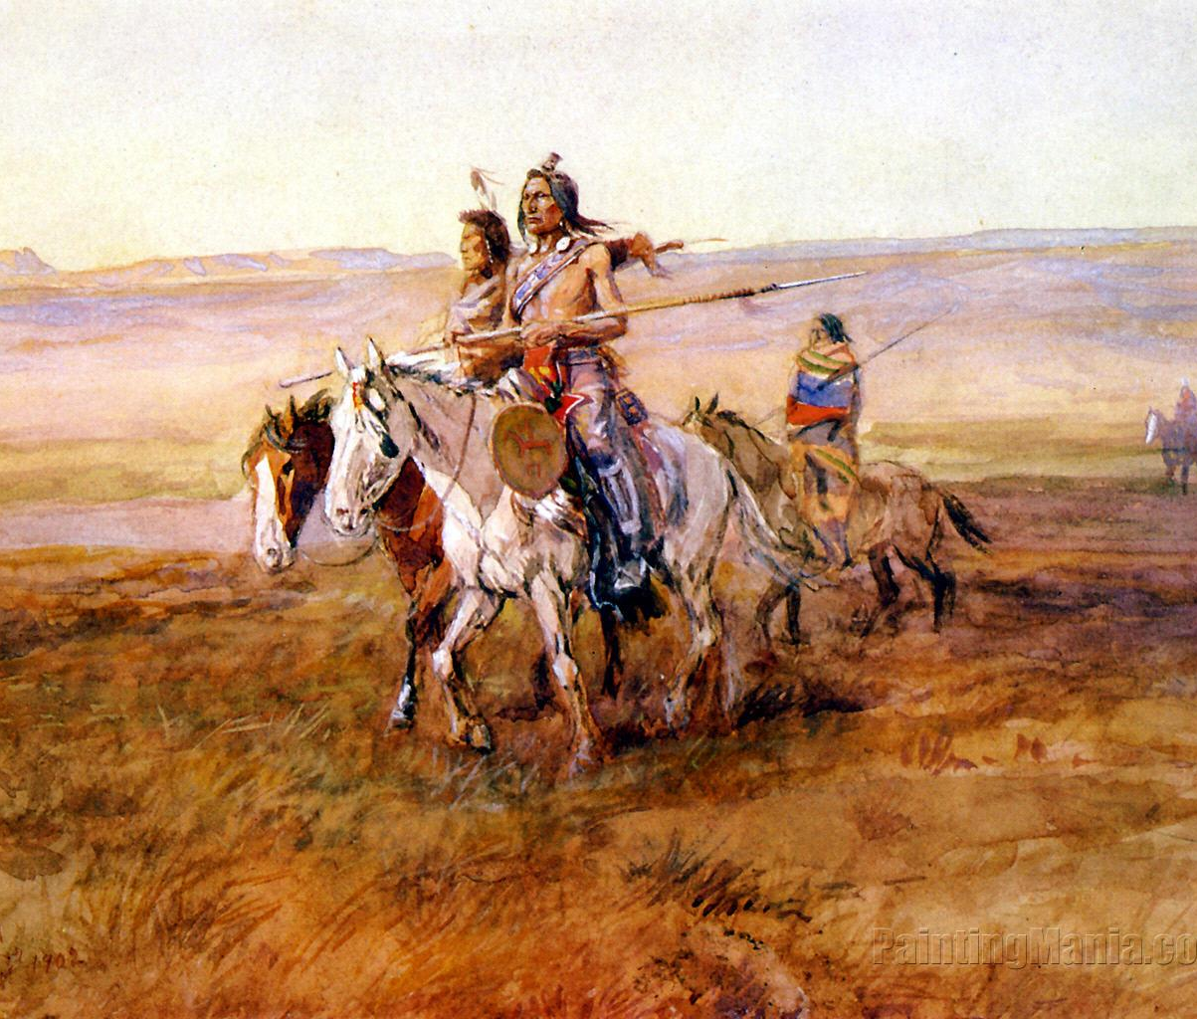
After horses were introduced to America, the way of life for many Plains Indians changed greatly.

Slide 13
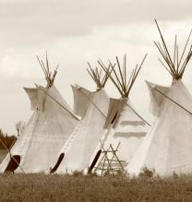
Some tribes became more mobile, following herds of buffalo, using the buffalo as their primary resource.

Slide 14
Think About It
How would these Native Americans have to change their lives to be more mobile?

Slide 15
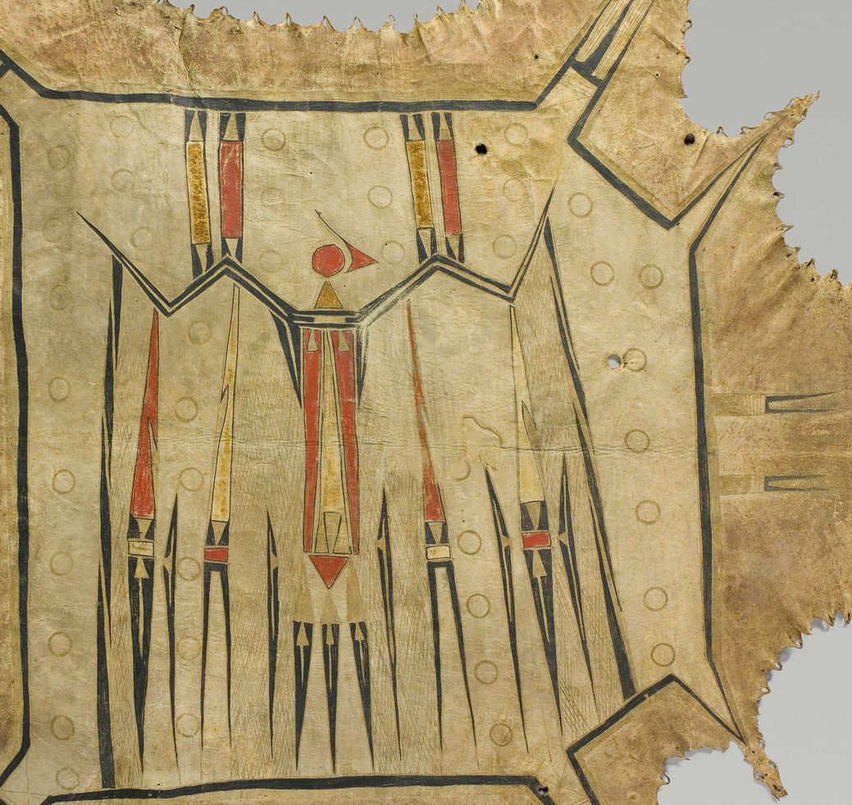
Plains Indians are known as being great artists. Most of their artwork, however, tended to be on thing they could carry with them, like clothing, tipis, carrying cases, etc.

Slide 16
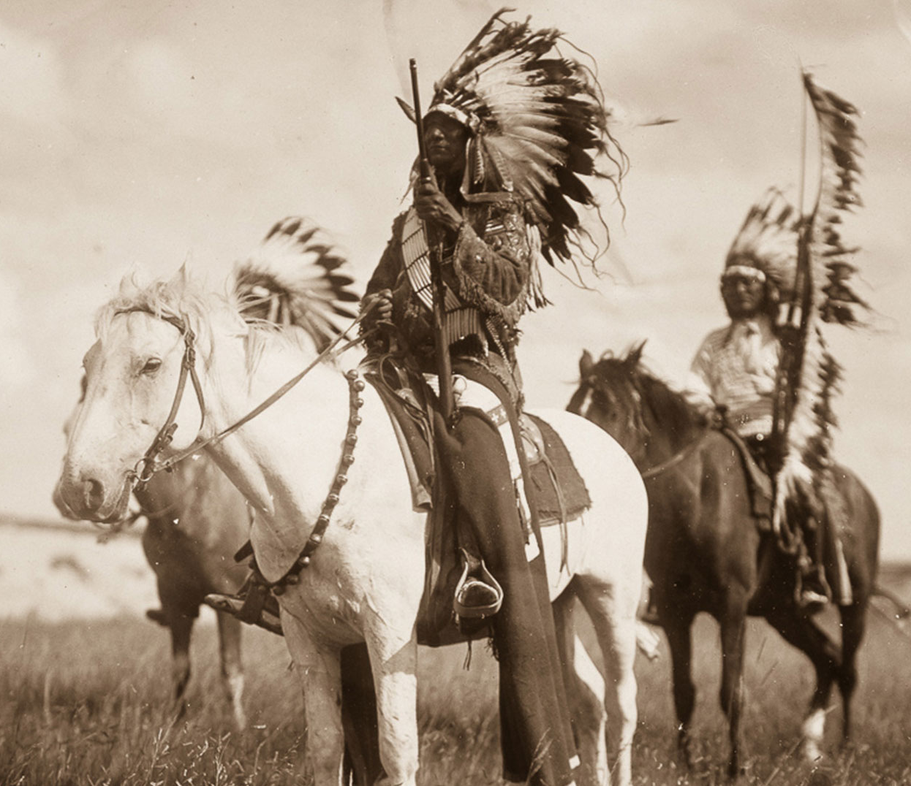
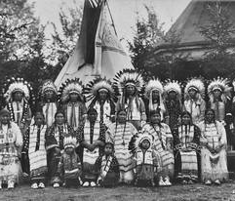
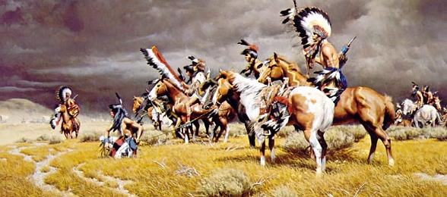
Some tribes of the Plains region include the Cheyenne, Apache, Lakota, Sioux, Crow, Blackfoot, and Shoshone.

Slide 17
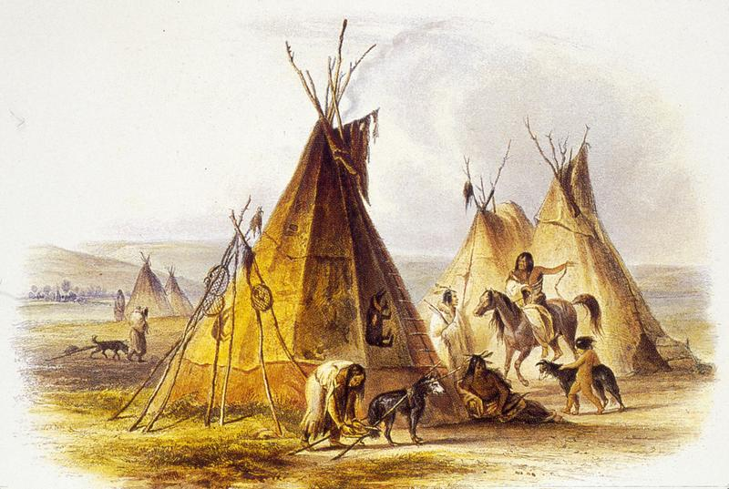
Video

